Slide 1
Bankruptcy prevention

Slide 2
Group Members
Mr. Sanket Nandurkar
Mr. Sushil Saini
Ms. Sona Sebastian
Ms. Aparna Patode
Mr. Venkata Prasad
Mr. Tirumala Chowdari
Mr. Saurabh Khawal

Slide 3

objective
The business objective is to create a classification model to predict whether a company will go bankrupt on based on features.
To predict the likelihood of a company going bankrupt based on provided features: industrial risk, management risk, financial flexibility, credibility, competitiveness, operating risk and class.
Promote sustainable business practice by identifying and addressing financial vulnerabilities early in the business cycle.
Assist Businesses in maintaining a healthy financial position and ensuring long-term stability by preventing bankruptcy.
Provide businesses with data driven insights to facilitate informed decision making related to financial strategies and resources allocation.

Slide 4

Introduction
Predictive modeling for “Bankruptcy Risk”. In the dynamic landscape of today’s business world, companies face numerous challenges. one of the most critical being the risk of bankruptcy. The ability to predict and prevent financial distress is paramount for sustaining a healthy business.
In this rapidly evolving environment, understanding the early signs of potential bankruptcy can mean the difference between a thriving enterprise and financial crisis. Today, we are excited to share our insights into a cutting-edge solution: predictive modeling.

Slide 5
Project architecture
Understanding the Business problem
Dataset understanding
EDA Process
Model Building
Model Evaluation
Model Selection
Deployment

Slide 6
Data insights
Dataset contains 250 rows & 7 columns.
Dataset containing 7 columns which are industrial risk, management risk, financial flexibility, credibility, competitiveness, operating risk are (float64 datatype) and class column (object datatype).
There are zero null values and zero missing values.
There are 147 duplicates values. Duplicates values were retained to preserve the original dataset’s integrity and prevent loss of valuable information during analysis.
These describe provide a comprehensive overview of the risk landscape for the companies in our dataset.
Correlation coefficients can provide insights into how different features are related.

Slide 7
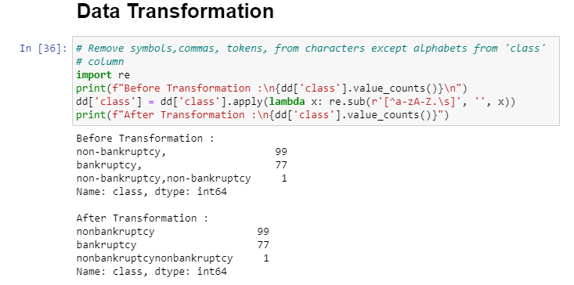
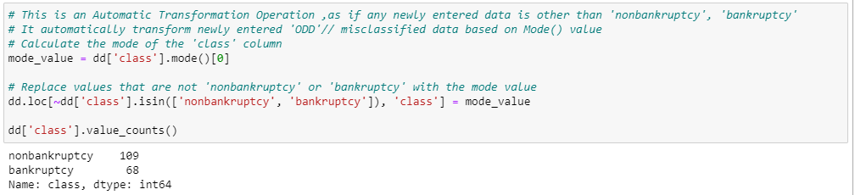
Data Transformation

Slide 8
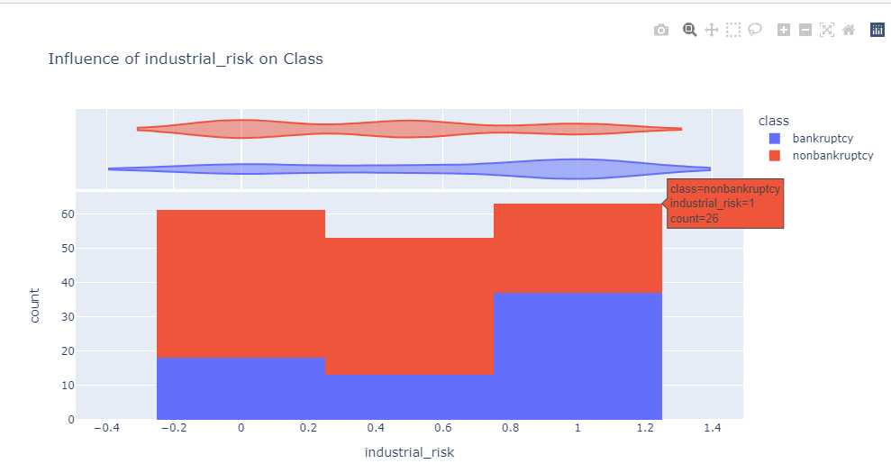
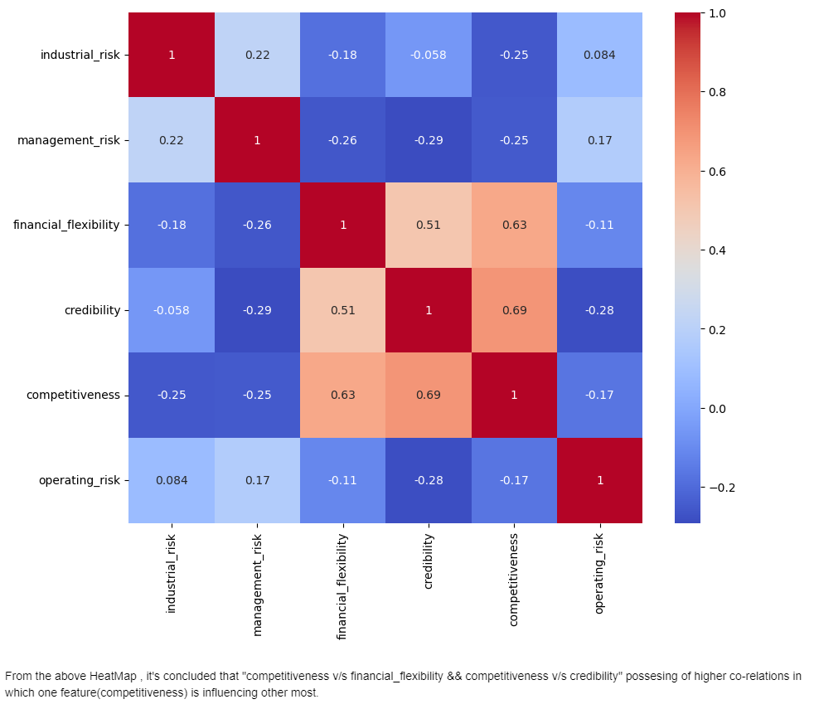
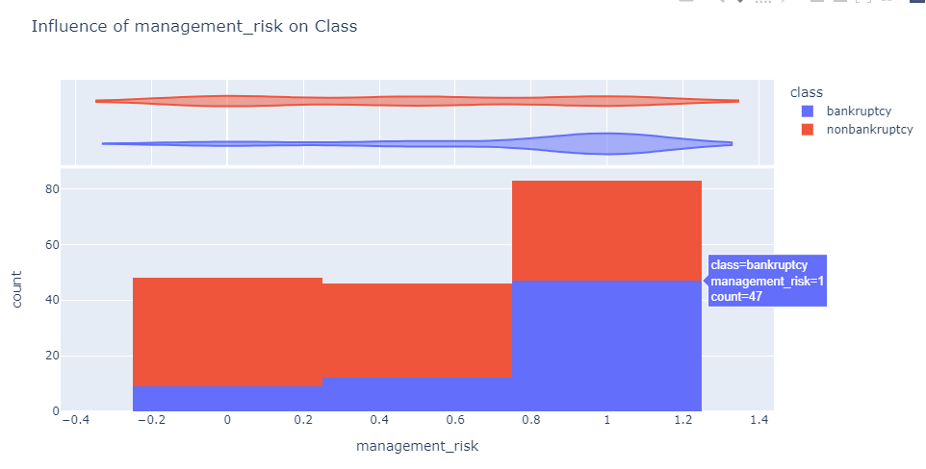
Data visualization

Slide 9
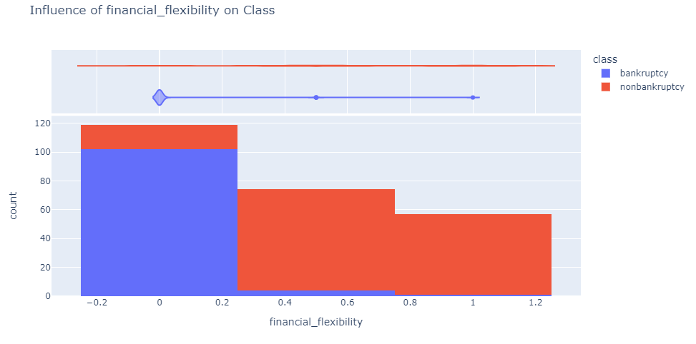
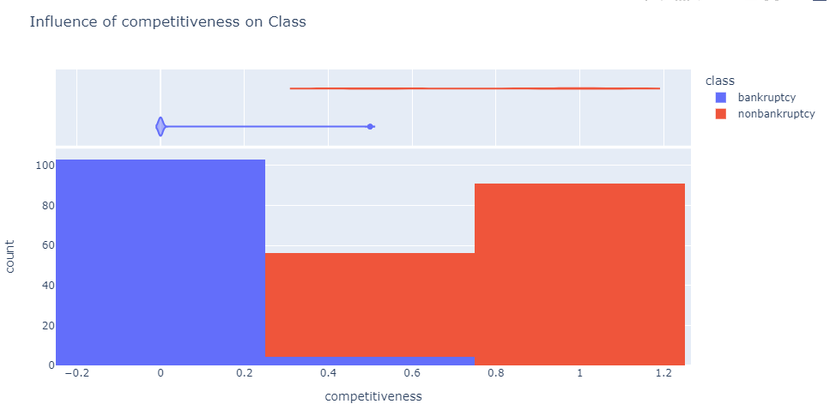
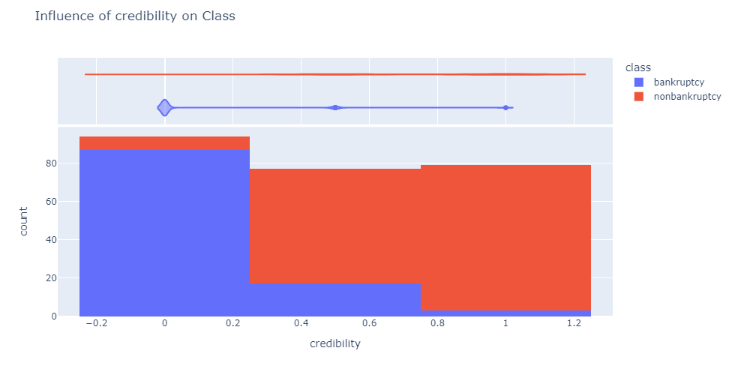
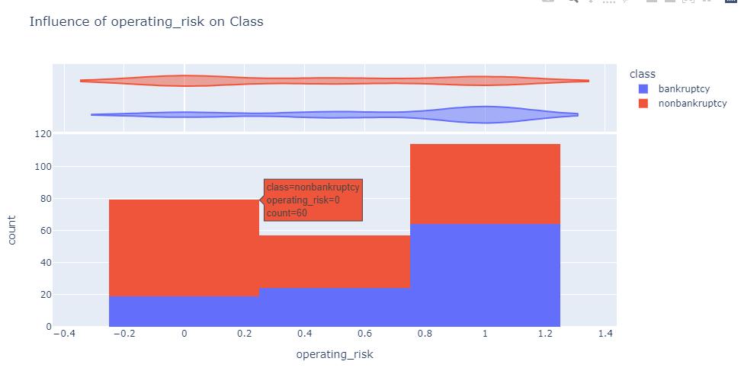
Data visualization

Slide 10
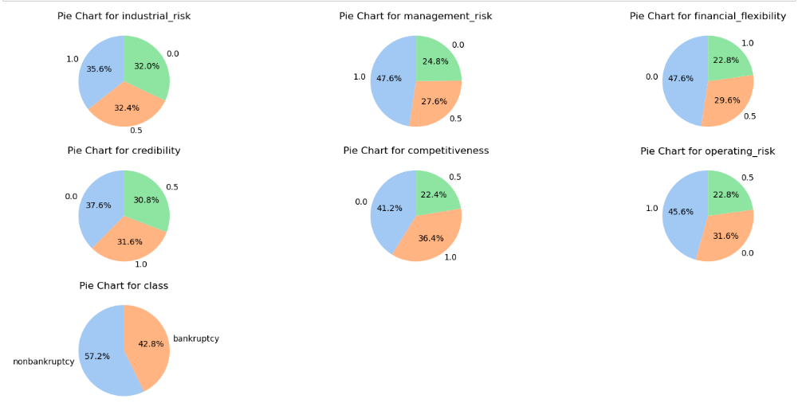
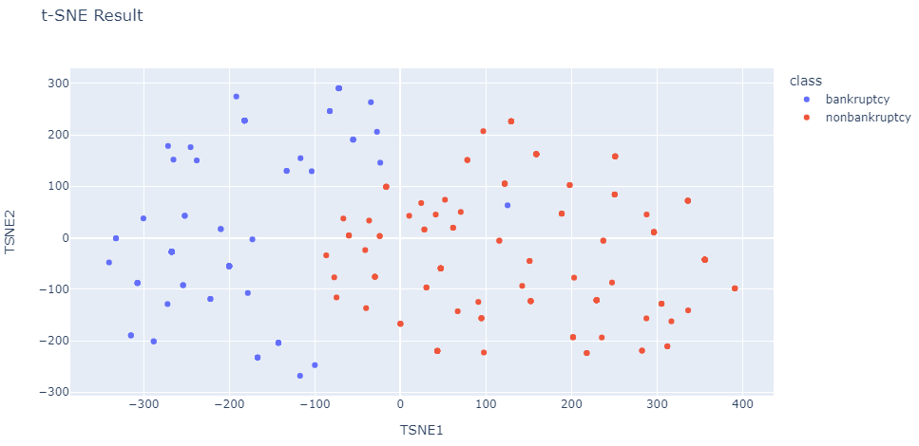
Data visualization

Slide 11
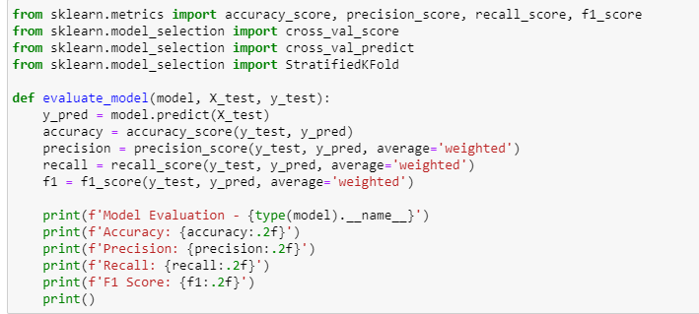
Model evaluation
By evaluating each model against ( Accuracy ,P recision,Recall,F1 score ) for obtaining optimal predicting algorithm.
Performing GridSearchCV for optimal parameter tuning to each model algorithm.

Slide 12
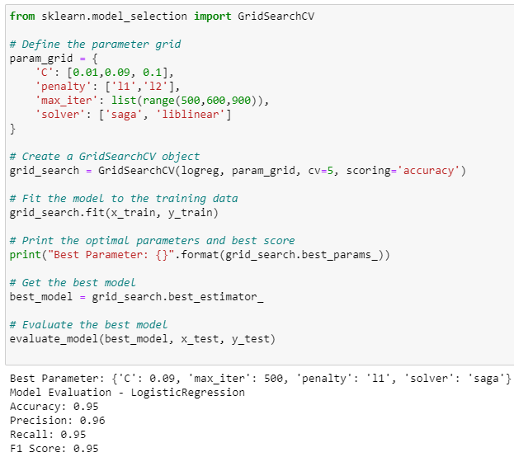
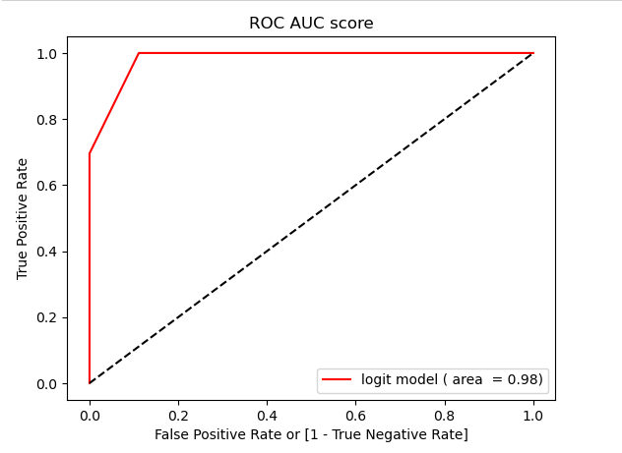
Logistic Regression Model evaluation

Slide 13
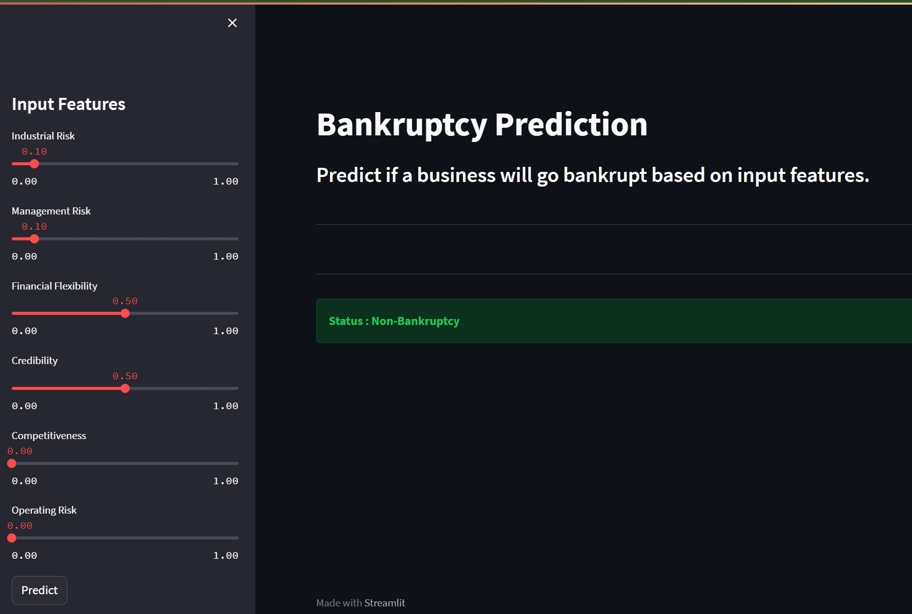
Deployment
Bankruptcy Prediction Global Deployment( Link )

Slide 14
Challenges
Data Quality: Often, bankruptcy prediction relies on financial data, which can be noisy or incomplete. Ensuring data quality through thorough preprocessing and validation is crucial.
Data Transformation: Removing symbols,commas, tokens, from characters except alphabets from 'class' dependent feature variable . Automatic Transformation Operation ,as if any newly entered data is other than 'nonbankruptcy', 'bankruptcy'
Feature engineering: We standardized the data and recognized the significance of characteristics in order to obtain more precision.
Model Selection: The most difficult task was choosing the best model with the highest accuracy rate in order to achieve good deployment precision.

Slide 15
Thank you

